Slide 1


2026 TRIENNIAL PROPERTY VALUE UPDATE OVERVIEW
KNOW YOUR
HOME VALUE!

Slide 2


Why Does the Franklin County Auditor’s Office Conduct Property Value Updates?
All county auditors in Ohio are required by law to update all property values by conducting a Reappraisal every six years, with a Property Value Update at the 3-year midpoint
This is an effort to accurately reflect property value changes in the current real estate marketplace
The Ohio Department of Taxation makes the final determination as to whether updated property values determined by the Auditor are accurate and acceptable
County Auditors may face legal action if the Dept of Taxation determines values are inaccurate and not subsequently corrected
KNOW YOUR
HOME VALUE!

Slide 3
What Happens During This Process?
The Property Value Update (2026) differs from a Reappraisal (2023) in that each property is NOT visually inspected
Rather, it involves a study and analysis of “arms-length” sales that have taken place in the past three years (2023 - 2025)
This helps the Auditor’s office determine whether a change in market value has taken place since the last reappraisal
KNOW YOUR
HOME VALUE!

Slide 4
What Is an Arms-Length Sale?
An arms-length sale is defined as a business deal between two or more parties where the parties act independently and in their own self interest, meaning the property is priced at the fair market value
In other words, a sale in which a family member sells a property to another family member for $1 would NOT be considered an arms-length sale
Sales such as this are not considered valid for the purposes of a Property Value Update and thus are not included in the recalculation of property values
KNOW YOUR
HOME VALUE!

Slide 5

When Does All This Happen?
January 1 2026
Franklin County Auditor’s Office collects sales data from preceding three years up to this date
March
2026
FCAO prepares to submit tentative values to Department of Taxation
April
2026
FCAO submits tentative values to Department of Taxation for approval
May - June
2026
FCAO receives approval of values from Taxation, prepares to send letters containing tentative property values to all Franklin County property owners
July - September
2026
Property owners may schedule a time to speak virtually or in person with a member of the FCAO appraisal team at a Property Value Review session, should they feel their tentative values are inaccurate. For those who participate in a Property Value Review, final values will be mailed in December 2026.
KNOW YOUR
HOME VALUE!

Slide 6

What Is Your Role in Establishing Your Updated Property Value?
JUNE
JULY - SEPT
DECEMBER
NOTICE OF PROPOSED PROPERTY VALUES
PROPERTY VALUE
REVIEWS
PROPERTY VALUES FINALIZED
All property owners can work with the Franklin County Auditor’s Office to provide information regarding their proposed values during the Property Value Review process
During this process, property owners may speak with a member of the Auditor’s office appraisal team, virtually or in person from late July to early September 2026
Property owners may provide our office with additional documentation in support of a different valuation
Your engagement will help us establish the proper valuation
KNOW YOUR
HOME VALUE!

Slide 7
Will the Property Value Update Affect Your Taxes?
Maybe. This appraisal process is statutorily required by Ohio law to provide tax districts with the most accurate property assessments possible. Thirty-five percent of the auditor’s assessed value is multiplied by your effective taxing district rate to determine your property taxes. It is important to remember the majority of taxes are established at the ballot box through your voted levies.
KNOW YOUR
HOME VALUE!

Slide 8
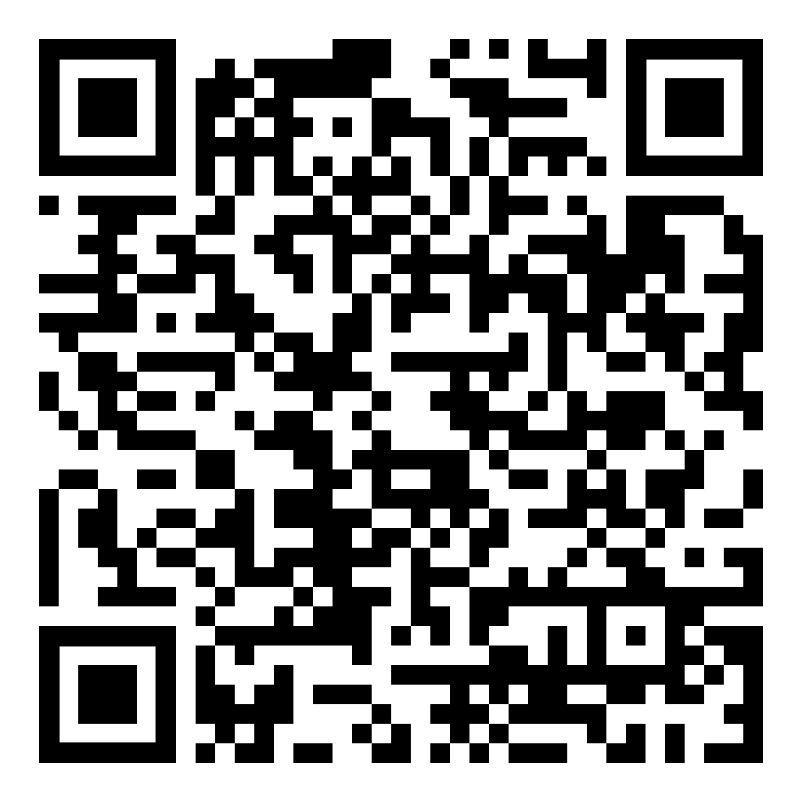
How Can the Auditor’s Office Help?
Franklin County residents are encouraged to contact the office at any time with questions about the 2026 Property Value Update, property taxes, or any other issues with which the Franklin County Auditor may be assistance, either by email at AuditorStinziano@franklincountyohio.gov or phone at (614) 525-HOME (4663)
Additionally, property owners concerned about a post-Update change in taxes can find more information and resources regarding the Board of Revision (BOR) process linked below. The BOR offers an additional step through which property owners may present evidence for an alternative property value, which could affect taxes owed.
Franklin County Board of Revision
KNOW YOUR
HOME VALUE!

Slide 9
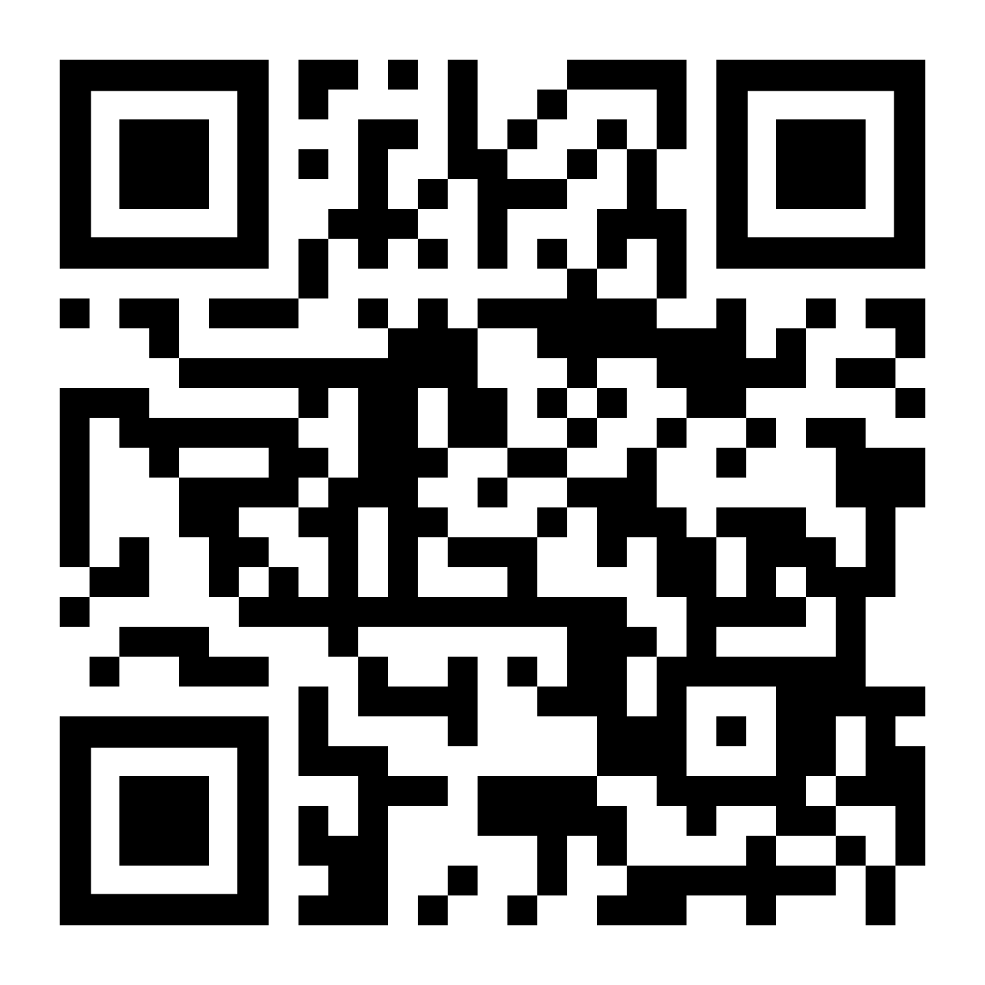
KNOW YOUR
HOME VALUE!
Additional information about the 2026 Property Value Update can be found at:
auditor.franklincountyohio.gov/KYHV
Thank You!

